Slide 1
Advancement of medical science
Using oneAPI Analytics toolkit
By Abhishek Nandy

Slide 2
Implementation of oneAPI Analytics toolkit in Medical Science
We will be exploring single cell data and porting Clustergrammer2 to oneAPI AI Analytics toolkit within Intel Devcloud.

Slide 3
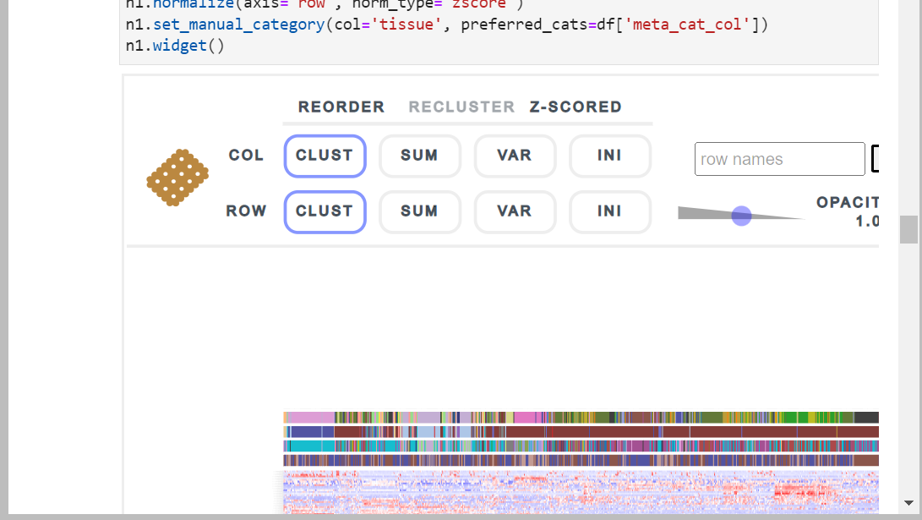

Slide 4
Features of Clustergrammer2
Zooming and panning
Allows users to zoom into and pan into the heatmap by scrolling and dragging
Mouse Over Interactions
Mousing over elements in the heatmap brings up an additional information using tooltips
Row and Column ordering
Interactive Dimensionality reduction
Dimensionality reduction is useful for data to be visualized

Slide 5
ClusterGrammer2
It is a web based tool for visualizing and analysing high dimensional data(eg:-Single Cell RNA Sequence) as interactive and sharable heatmaps within Intel Devcloud.
We will be exploring gene expression data that has got very good implementation in terms of studying diseases such as cancer.
The moment we explore heatmaps it gives us insight into where mutation has been caused in the gene data for cancer.

Slide 6
Porting Clustergrammer2 to oneAPI AI Analytics toolkit allows us to use Scikit backend powered by Intel Architecture.
It allows us to analyse the data interactively which is suppose to be a high dimensional data that is 2700 PBMC’s(peripheral blood mononuclear cell) obtained from 10x Genomics dataset.
The notebook is powered by Intel Extension for Scikit learn

Slide 7
Installation of Clustergrammer2 on Jupyter notebook
We need to create a new notebook using the python 3.x extension with Intel oneAPI .
Then we have to first install Clustergrammer2
!pip install --upgrade clustergrammer2

Slide 8
We first access some libraries that we need for implementations.
The most important one being Clustergrammer2.
Next we implement some functions.
We have to load the dataset. It's not a normal dataset we are using. This is a genome assembly or gene sequence data that is a sparse matrix.
Size of the pandas data frame
32 thousand rows---genes
2700 columns ---single Cells
Very High dimensional

Slide 9
We will drop some gene types that we don’t need or interested into.
We find the top expressing genes.
We will next perform normalization such that each cell has the same UMI count.

Slide 10
Finally we go through Arc Sinh transform and z-score for the dataset as a means of distribution.
After all normalization part we are loading the data in the Clustergrammer 2 widget.
The data represents 2700 columns and 250 variable genes.
We can analyse the data now.

